Slide 1
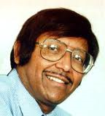
Dr.K.A.Galil.
DDS.,D.Oral&maxilloacial Suregery,Ph.D.,FAGD.,FADI.,cert.Periodontist (Royal College)
I teach in clinical anatomy ,orthodontics and Periodontics. My interest in imaging crosses those three disciplines mentioned previously as well as Egyptology. I am proud to be at the present time the only Canadian who has imaged (X-rayed) the Royal pharaohs and contributed to two books on this topic
This was an interest project and at one time I served as a co-director of the Project

Slide 2
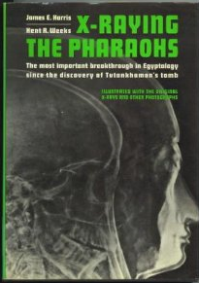
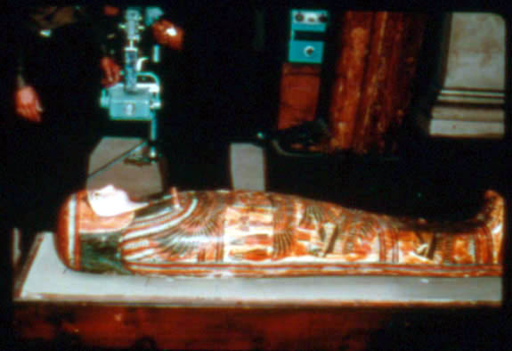
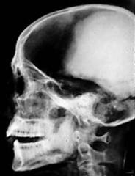
X-ray Unit
Dr .Galil
Sarcophagus
radiograph of the Great Ramses the II

Slide 3
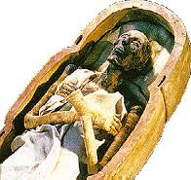
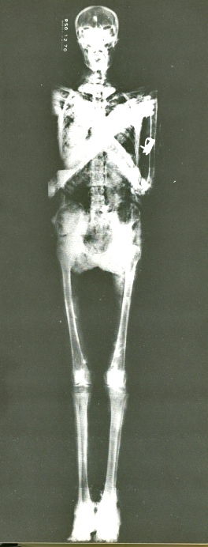
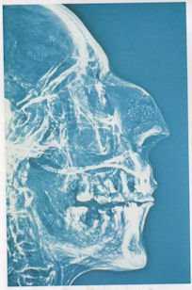
Head of Ramses the 2nd
Ramses the 2nd on his death bed ,with a raised hand ,symbol of power
Full Body X-ray

Slide 4
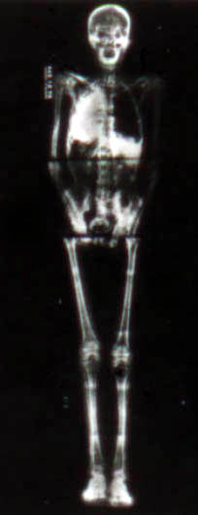
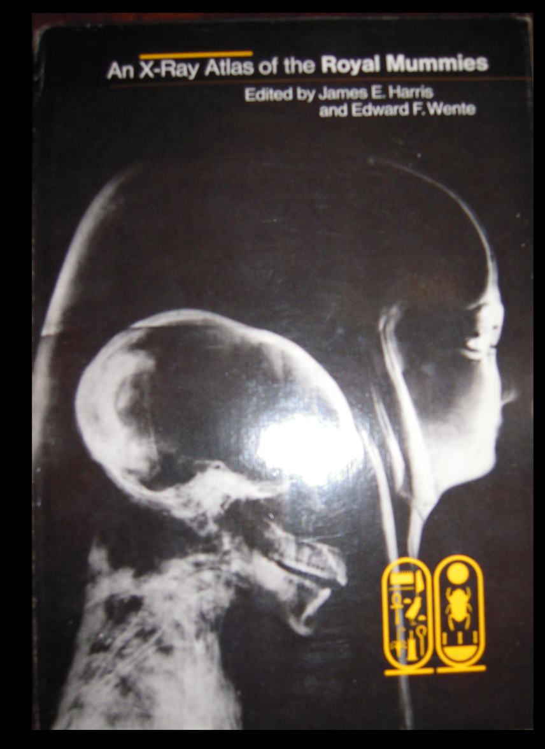
This book has all the full body X-rays of the mummies

Slide 5
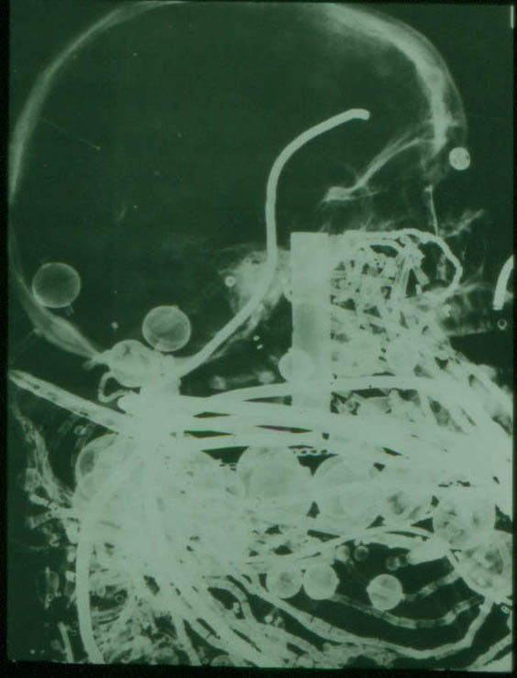
One of the interesting discovery of x-raying the pharaoh’s is the amount of Gold inside the mummy of course the anthropomorphic measurements were also very interesting

Slide 6
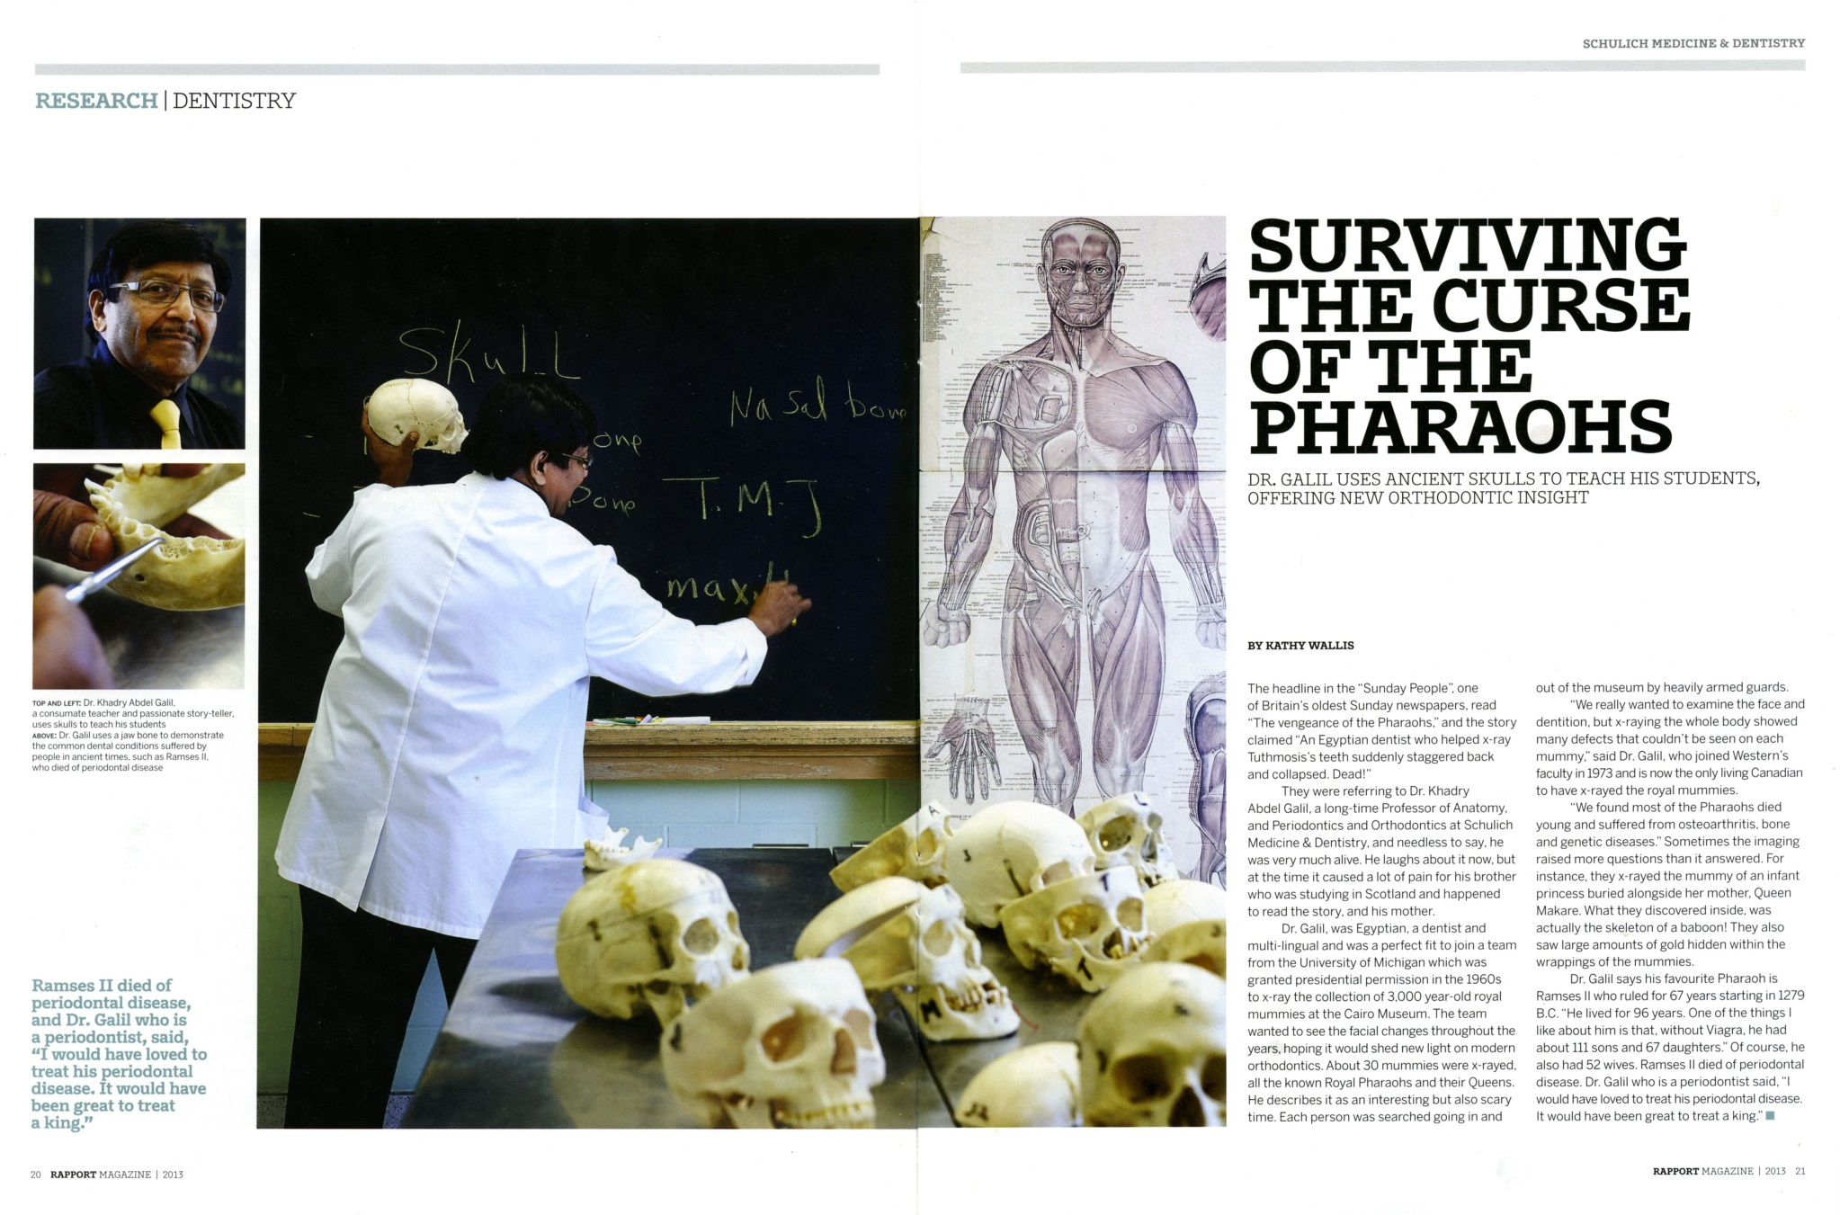
published in the Journal Titled RAPPORT Schulich School of Medicine & Dentistry
Western University / AluMni Magazine / 2013 page 20-21

